Slide 1
E-Commerce and Technologies
Online Retail and Services

Slide 2
Objectives
Describe the environment in which the online retail sector operates today.
Explain how to analyze the economic viability of an online firm.
Identify the challenges faced by the different types of online retailers.
Describe the major features of the online service sector.
Discuss the trends taking place in the online financial services industry.
Describe the major trends in the online travel services industry today.
Identify current trends in the online career services industry.

Slide 3
Major Trends in Online Retail 2009–2010
Growth in social shopping
Online retail remained profitable during recession
Online retail still fastest growing retail channel
Buying online a normal, mainstream experience
Selection of goods increases, includes luxury goods
Informational shopping for big-ticket items expands
Specialty retail sites show most rapid growth

Slide 4
The Retail Sector
Most important theme in online retailing is effort to integrate online and offline operations
U.S. retail market accounts for over $9.7 trillion (70%) of total GDP
Personal consumption:
60% services
29% nondurable goods
11% durable goods
Distinction between “goods” and “services” becoming more ambiguous

Slide 5
The Retail Industry
Nine segments (clothing, durable goods, etc.)
Each offers different opportunities for online retail
Information
Direct purchasing
General merchandisers vs. specialty retailers
Mail order/telephone order (MOTO) sector most similar to online retail sector
Sophisticated order entry, delivery, inventory control systems

Slide 6
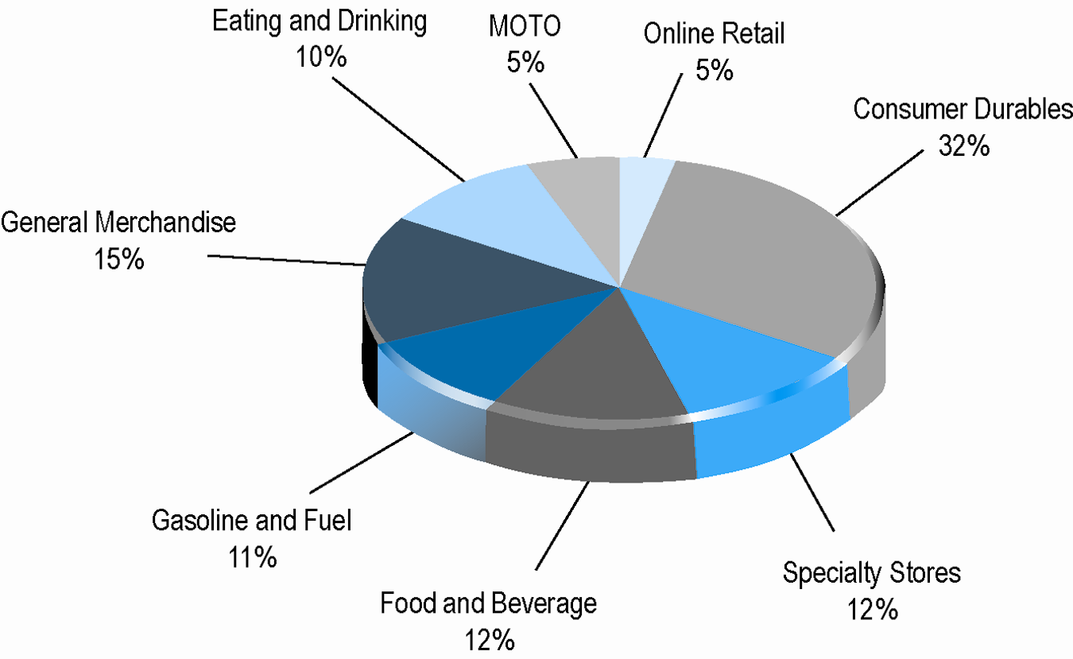
Composition of the U.S. Retail Industry

Slide 7
E-commerce Retail: The Vision
Greatly reduced search and transaction costs would result in customers using Web to find lowest prices
Market entry costs would be lower than those for physical storefronts, and online merchants would be more efficient than offline competitors
Traditional offline physical store merchants would be forced out of business
Some industries would become disintermediated as manufacturers built direct relationship with consumer
Few of these assumptions were correct—structure of retail marketplace has not been revolutionized
Internet has created new venues for multichannel firms and supported a few pure-play merchants

Slide 8
The Online Retail Sector Today
Smallest segment of retail industry (5%)
Growing at faster rate than offline segments
Revenues flat during recession, expected to continue growth between 2010–2013
70% Internet users bought online in 2009
Primary beneficiaries:
Established offline retailers with online presence (e.g., Staples)
First mover dot-com companies (e.g., Amazon)

Slide 9
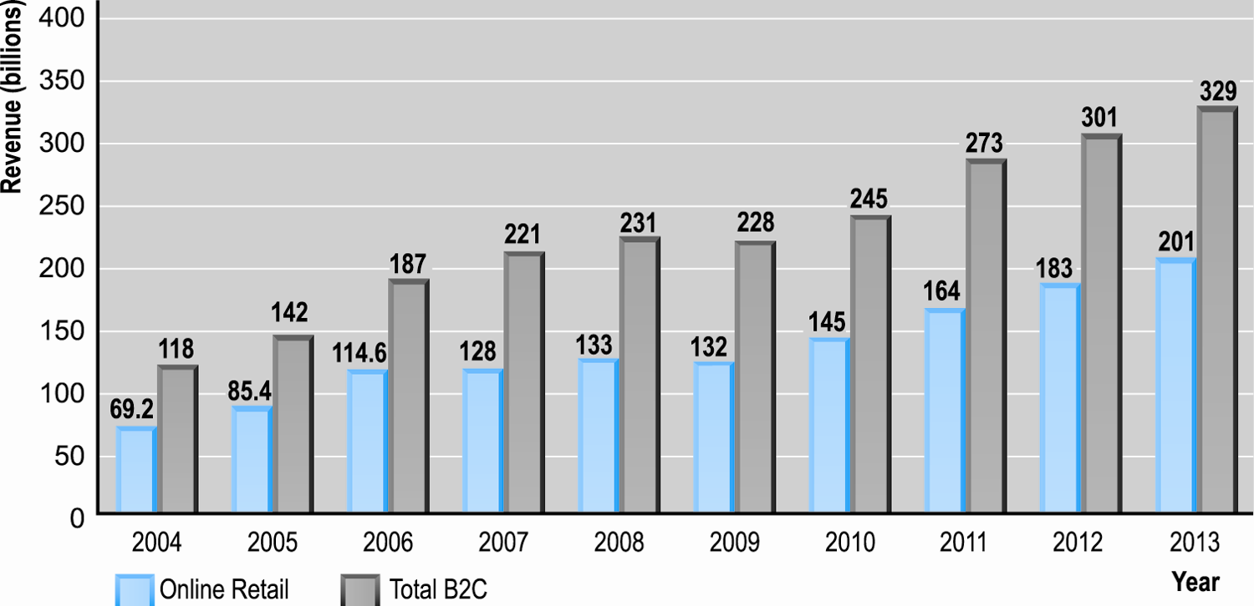
Online Retail and B2C E-commerce Is Alive and Well
SOURCES: eMarketer, 2009a; U.S. Department of Commerce, 2009; Forrester Research, 2008; authors’ estimates.

Slide 10
Multi-Channel Integration
Integrating Web operations with traditional physical store operations
Provide integrated shopping experience
Leverage value of physical store
Types of integration
Online order, in-store pickup
Online order, store directory and inventory
In-store kiosk or clerk Web order, home delivery
Web order, in-store returns and adjustments
Online Web catalog
Web promotions to drive customers to stores
Gift cards, program points usable in any channel

Slide 11
Analyzing the Viability of Online Firms
Economic viability:
Ability of firms to survive as profitable business firms during specified period (i.e., 1–3 years)
Two business analysis approaches:
Strategic analysis
Focuses on both industry as a whole and firm itself
Financial analysis
How firm is performing

Slide 12
Strategic Analysis Factors
Key industry strategic factors
Barriers to entry
Power of suppliers
Power of customers
Existence of substitute products
Industry value chain
Nature of intra-industry competition
Strategic factors related to specific firm
Firm value chain
Core competencies
Synergies
Technology
Social and legal challenges

Slide 13
Financial Analysis Factors
Statements of Operations
Revenues
Cost of sales
Gross margin
Operating expenses
Operating margin
Net margin
Balance sheet
Assets, current assets
Liabilities, current liabilities and long-term debt
Working capital

Slide 14
E-tailing Business Models
Four main online retail business models:
Virtual merchant
Amazon
Bricks-and-clicks
Wal-Mart, J.C. Penney, Sears
Catalog merchant
Lands’ End, L.L. Bean, Victoria’s Secret
Manufacturer-direct
Dell

Slide 15
E-commerce in Action: Amazon.com
Vision:
Earth’s biggest selection, most customer-centric
Business model:
Amazon Retail, Third Party Merchants, and Amazon Web Services (merchant and developer services)
Financial analysis:
Greatly improved, profitable; still heavy long-term debt
Strategic analysis/business strategy:
Maximize sales volume, cut prices
Strategic analysis/competition:
Online and offline general merchandisers

Slide 16
E-commerce in Action: Amazon.com
Strategic analysis/technology:
Largest, most sophisticated collection of online retailing technologies available
Strategic analysis/social, legal:
Antitrust, sales tax, patent lawsuits
Toys’R’Us lawsuit
Future prospects:
In 2008, net sales grew 30%
Ranks among top five in customer service, speed, accuracy
However, net margins still much narrower than Wal-Mart

Slide 17
Common Themes in Online Retailing
Online retail fastest growing channel on revenue basis
Profits for startup ventures have been difficult to achieve
Disintermediation has not occurred
Most significant online growth: offline general merchandiser giants extending brand to online channel
Second area of rapid growth:
Specialty merchants with high-end goods, e.g., Blue Nile

Slide 18
The Service Sector: Offline and Online
Service sector:
Largest and most rapidly expanding part of economies of advanced industrial nations
Concerned with performing tasks in and around households, business firms, and institutions
Includes doctors, lawyers, accountants, business consultants, etc.
76% of U.S. labor force—108 million
58% of GDP—$7.7 trillion

Slide 19
Service Industries
Major service industry groups:
Finance
Insurance
Real estate
Travel
Professional services—legal, accounting
Business services—consulting, advertising, marketing, etc.
Health services
Educational services

Slide 20
Service Industries
Companies can be further categorized as:
Transaction brokers
Hands-on service providers
Services industry features:
Knowledge- and information-intense
Makes them uniquely suited to e-commerce applications
Amount of personalization and customization required differs depending on type of service
E.g., medical services vs. financial services

Slide 21
Online Financial Services
Example of e-commerce success story, but success is somewhat different from what had been predicted
Brokerage industry transformed
4 of 5 households use online banking
Effects less powerful in insurance, real estate
Multi-channel established financial services firms continue to show strong growth

Slide 22
Financial Service Industry Trends
Two important global trends
Industry consolidation
Financial Reform Act of 1998 amended Glass-Steagall Act and allows banks, brokerages, and insurance firms to merge
Movement toward integrated financial services
Financial supermarket model

Slide 23
Online Financial Consumer Behavior
Consumers attracted to online financial sites because of desire to save time and access information rather than save money
Most online consumers use financial services firms for mundane financial management
Check balances
Pay bills
Greatest deterrents are fears about security and confidentiality

Slide 24
Online Banking and Brokerage
Online banking pioneered by NetBank and Wingspan; no longer in existence
Established brand-name national banks have taken substantial lead in market share
Over 100 million people use online banking; expected to rise to 192 million in 2013
Early innovators in online brokerage (E*Trade) have also been displaced by established brokerages (Fidelity, Schwab)

Slide 25
Multi-channel vs. Pure Online Financial Service Firms
Online consumers prefer multi-channel firms with physical presence
Multi-channel firms
Growing faster than pure online firms
Lower online customer acquisition costs
Pure online firms
Rely on Web sites, advertising to acquire customers
Users utilize services more intensively
Users shop more, are more price-driven and less loyal

Slide 26
Financial Portals and Account Aggregators
Financial portals
Comparison shopping services, independent financial advice and financial planning
Revenues from advertising, referrals, subscriptions
E.g., Yahoo! Finance, Quicken.com, MSN Money
Account aggregation
Pulls together all of a customer’s financial data at a personalized Web site
E.g., Yodlee: provides account aggregation technology
Privacy concerns; control of personal data, security, etc.

Slide 27
Online Mortgage and Lending Services
Early entrants hoped to simplify and speed up mortgage value chain
Many early pure-online firms failed due to difficulties of developing brand and simplifying mortgage generation process
Three kinds of online mortgage vendor today
Established online banks, brokerages, and lending organizations
Pure online mortgage bankers
Mortgage brokers
Online mortgage industry has not transformed process of obtaining mortgage
Complexity of process

Slide 28
Online Insurance Services
Online term life insurance:
One of few products for which Internet lowered search costs, increased price comparison, and resulted in lower prices
Other insurance product lines:
Web gives insurance companies new opportunities for product and service differentiation and price discrimination
Online use is more for discovering prices and terms of policies than purchasing policies online
Reduced search and price discovery costs
Industry affected by being regulated at state as opposed to federal level

Slide 29
Online Real Estate Services
Early vision: local, complex, and agent-driven real estate industry would transform into disintermediated marketplace where buyers and sellers would transact directly
However, major impact is influencing of purchases offline
Impossible to complete property transaction online
Main services are online property listings, loan calculators, research, and reference material
Despite revolution in available information, there has not been a revolution in the industry value chain

Slide 30
Online Travel Services
One of most successful B2C e-commerce segments
2007: first year online bookings greater than offline
2009: online travel bookings declined slightly due to recession but expected to grow to $118 billion by 2013
For consumers: more convenient than traditional travel agents
For suppliers: a singular, focused customer pool that can be efficiently reached through onsite advertising

Slide 31
Online Travel Services
Travel an ideal service/product for Internet
Information-intensive product
Electronic product—travel arrangements can be accomplished for the most part online
Does not require inventory
Does not require physical offices with multiple employees
Suppliers are always looking for customers to fill excess capacity
Does not require an expensive multi-channel presence

Slide 32
The Online Travel Market
Four major sectors:
Airline tickets
Hotel reservations
Car rentals
Cruises/tours
Two major segments:
Leisure/unmanaged business travel
Managed business travel—expected to be a major growth area as corporations seek better control of corporate travel expenses
Corporate online-booking solutions (COBS)

Slide 33
Online Travel Industry Dynamics
Intense competition among online providers
Price competition difficult
Industry consolidation
Stronger, offline established firms purchasing weaker online firms to create multi-channel travel sites
Industry impacted by meta-search engines
Commoditize online travel
Suppliers are attempting to eliminate intermediaries—global distribution systems and travel agencies—using Web as means

Slide 34
Online Career Services
Top sites generate over $1 billion annually
Three main players: CareerBuilder, Monster, HotJobs
Traditional recruitment:
Classified, print ads, career expos, on-campus recruitment, staffing firms, internal referral programs
Online recruiting
More efficient, cost-effective, reduces total time-to-hire
Enables job hunters to more easily distribute resumes while conducting job searches
Ideally suited for Web due to information-intense nature of process

Slide 35
It’s Just Information: The Ideal Web Business?
Recruitment ideally suited for Web
Information-intense process
Initial match-up doesn’t require much personalization
Saves time and money for both job hunters and employers
One of the most important functions: ability to establish market prices and terms (online national marketplace)

Slide 36
Recruitment Market Segments
Three major segments
General job recruitment:
Largest segment and primary focus
Executive search:
Highest revenue potential
Specialized job placement services:
Often run by professional societies
Online recruitment has focused on general job market, but increasing services for executive recruiting

Slide 37
Online Recruitment Industry Trends
Consolidation:
CareerBuilder, Monster, and HotJobs together dominate the market
Diversification: niche employment sites
Localization:
Local boards compete with local newspapers, Craigslist
Job search engines/aggregators:
“Scraping” listings: Indeed.com, JobCentral
Social networking:
LinkedIn; Facebook apps

